Slide 1
应用统计与深度学习实验课
高婷
2021年9月30日

Slide 2
Recap
Data manipulation tools (Lesson1.1.ipynb)
Pytorch basics for deep learning:
Linear Regression from scratch (Lesson1.2.ipynb)
Multi-class classification (Lesson1.3.ipynb)
MLP and how to customize its components. (Lesson 2.1.ipynb)
Modern techniques and models: CNN/ ResNet (Lesson 2.2.ipynb)
Model training pipeline and tensorboard practice. (Lesson 2.3.ipynb)

Slide 3
Outline for today
Sequence Model:
RNN, LSTM (Lesson 3.1.ipynb)
Generative Model:
VAE, GAN (Lesson 3.2.ipynb)

Slide 4
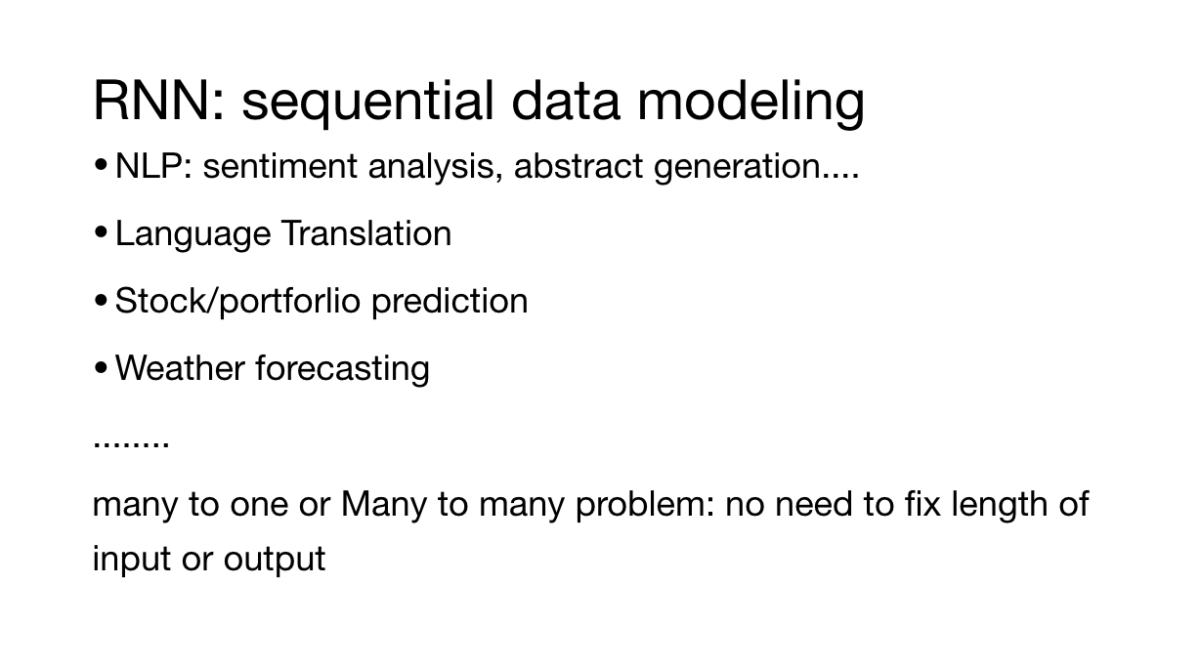

Slide 5
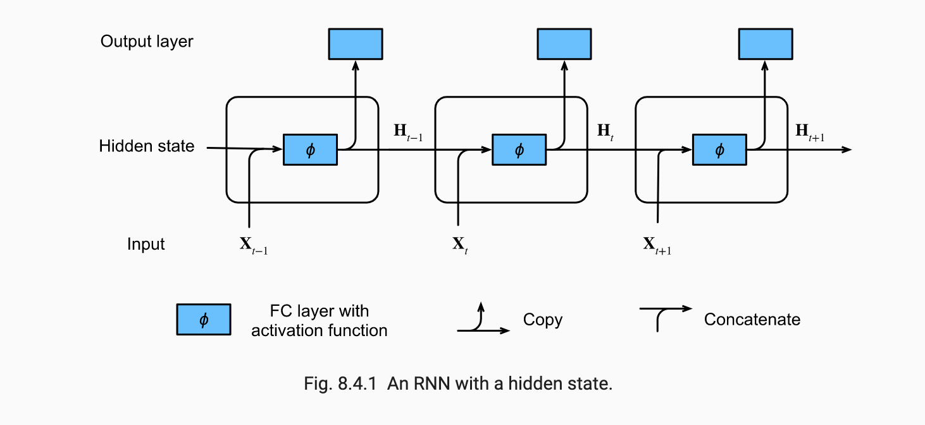
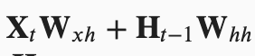

Slide 6
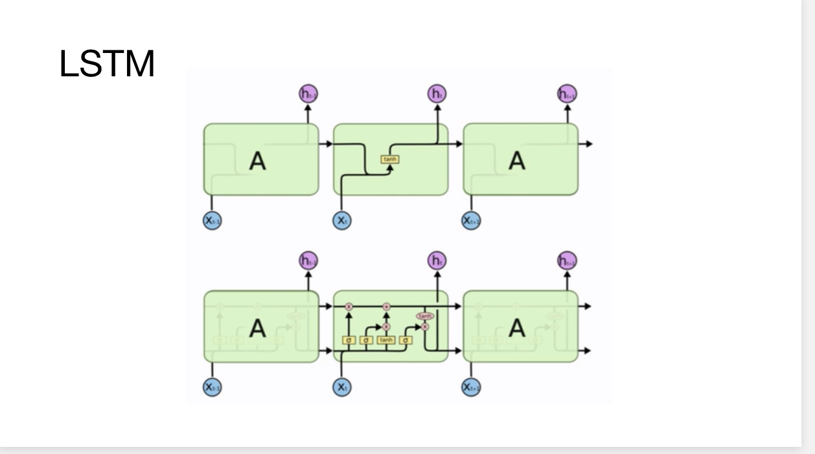

Slide 7
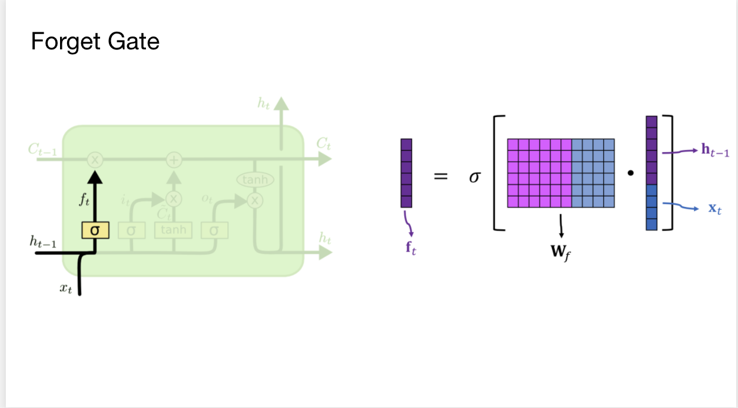

Slide 8
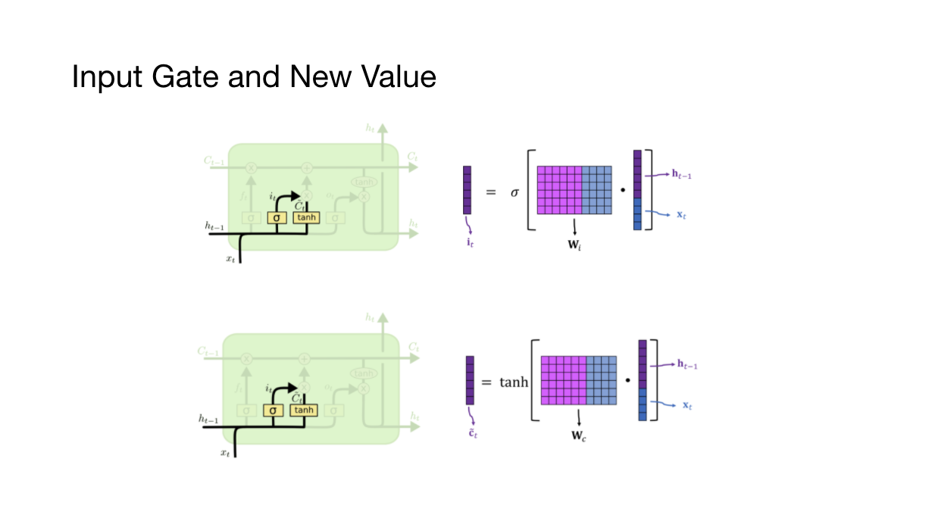

Slide 9
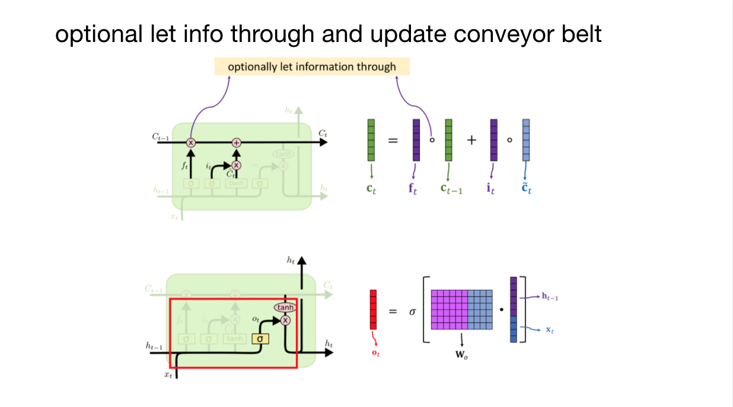

Slide 10
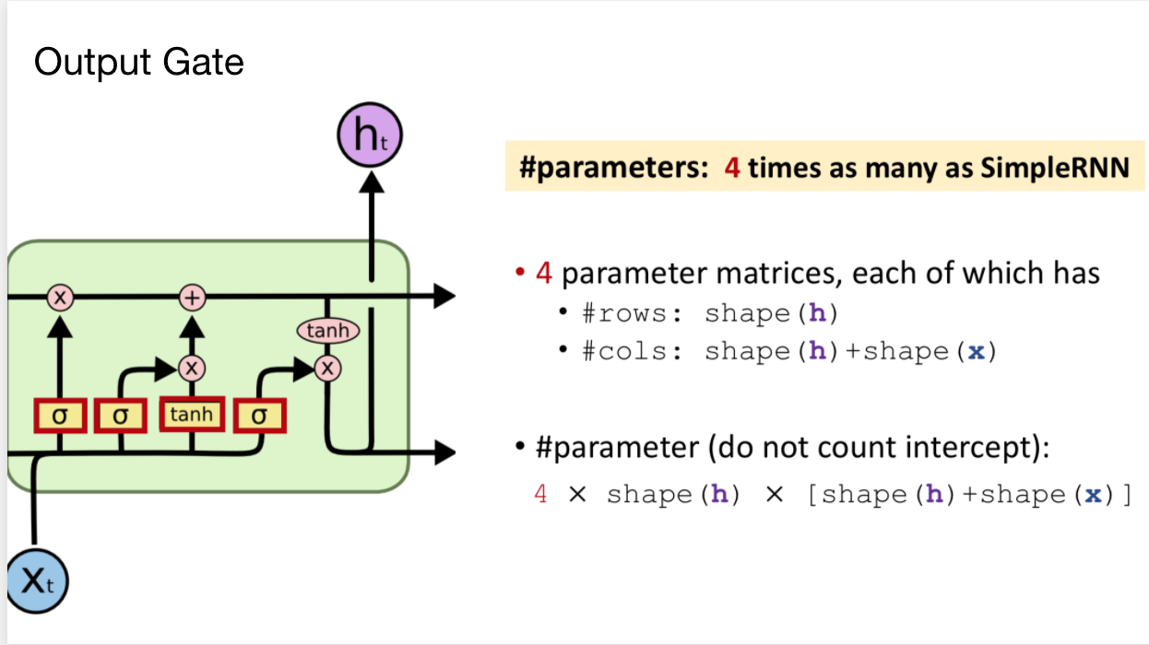

Slide 11
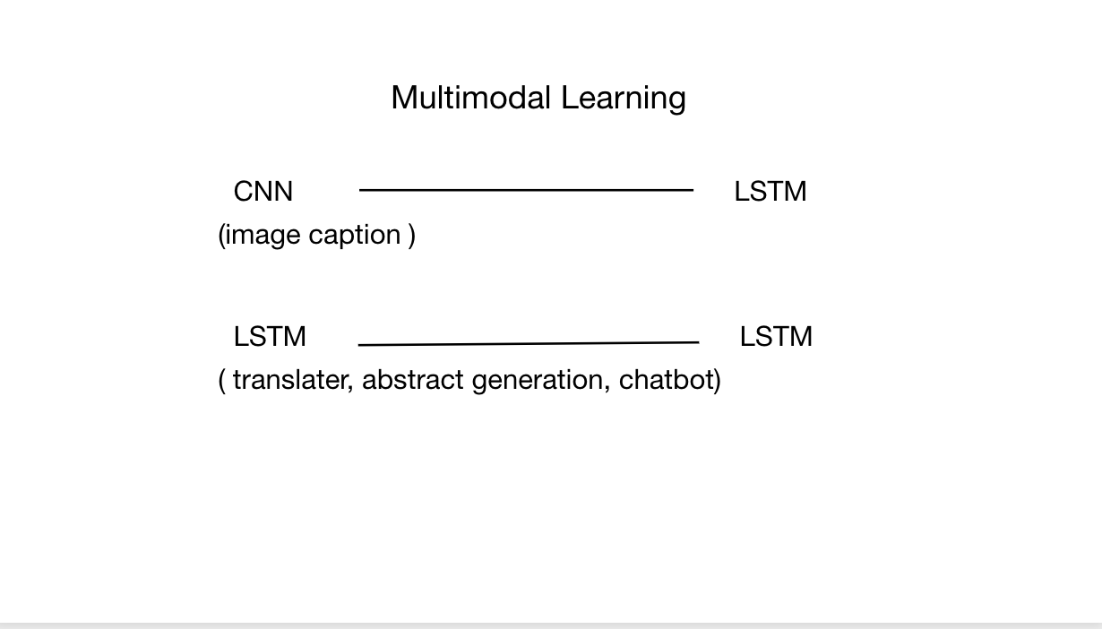

Slide 12
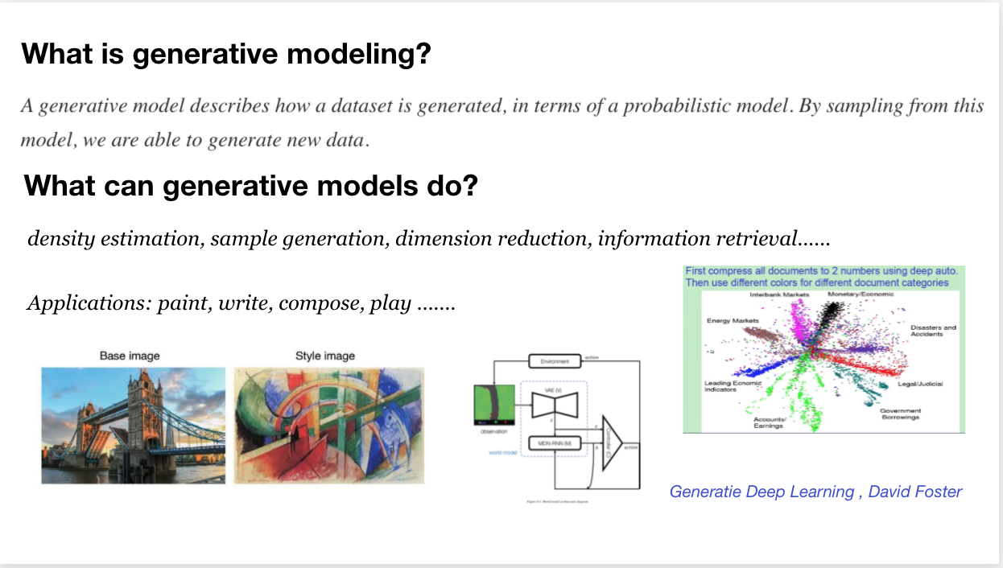

Slide 13
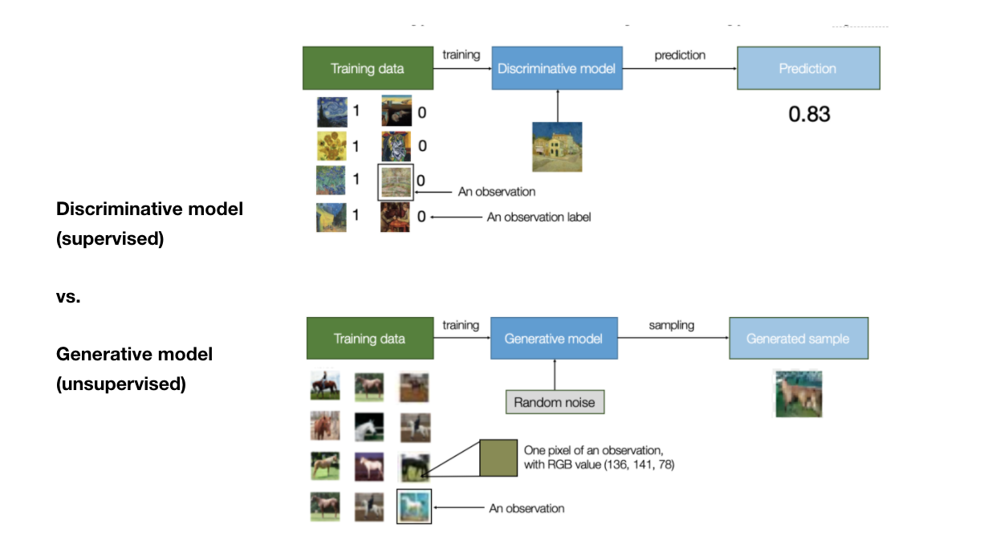

Slide 14
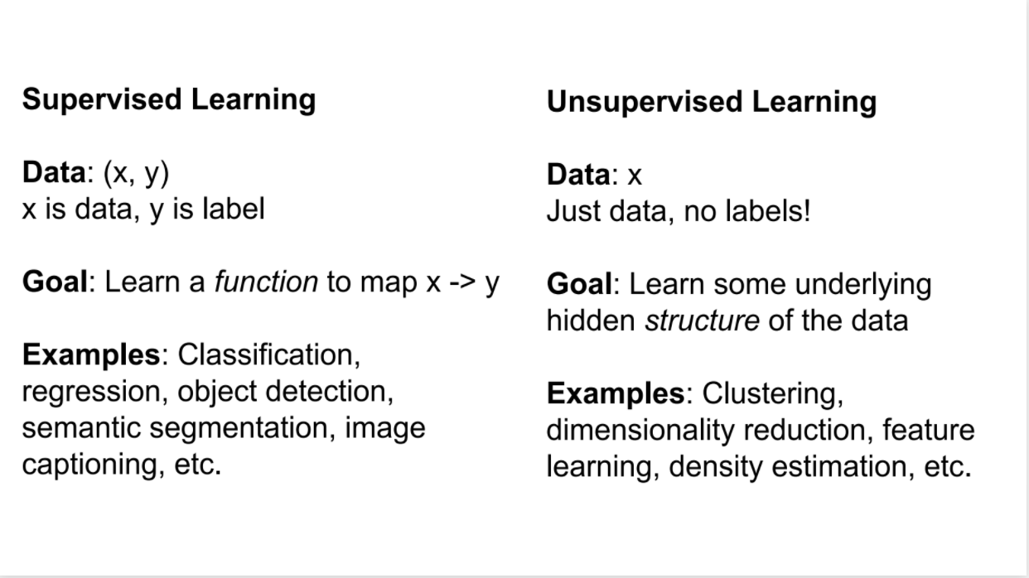

Slide 15
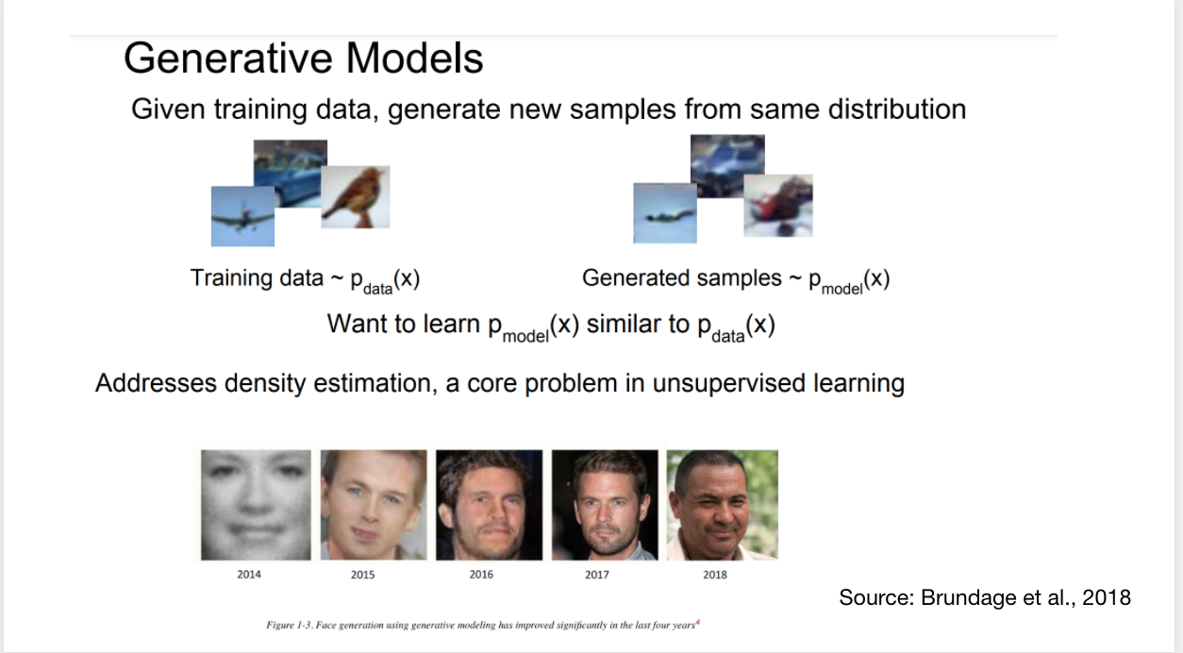

Slide 16
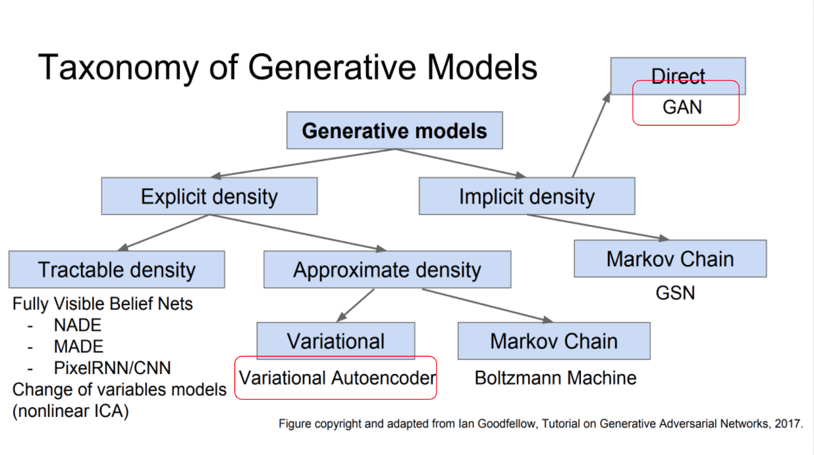

Slide 17
VAE: Variational Auto Encoder

Slide 18
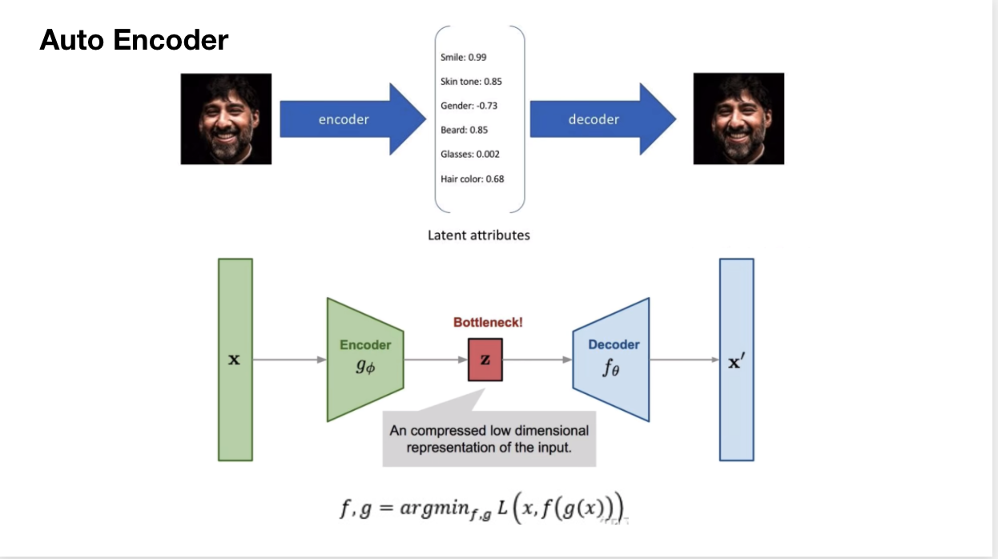

Slide 19
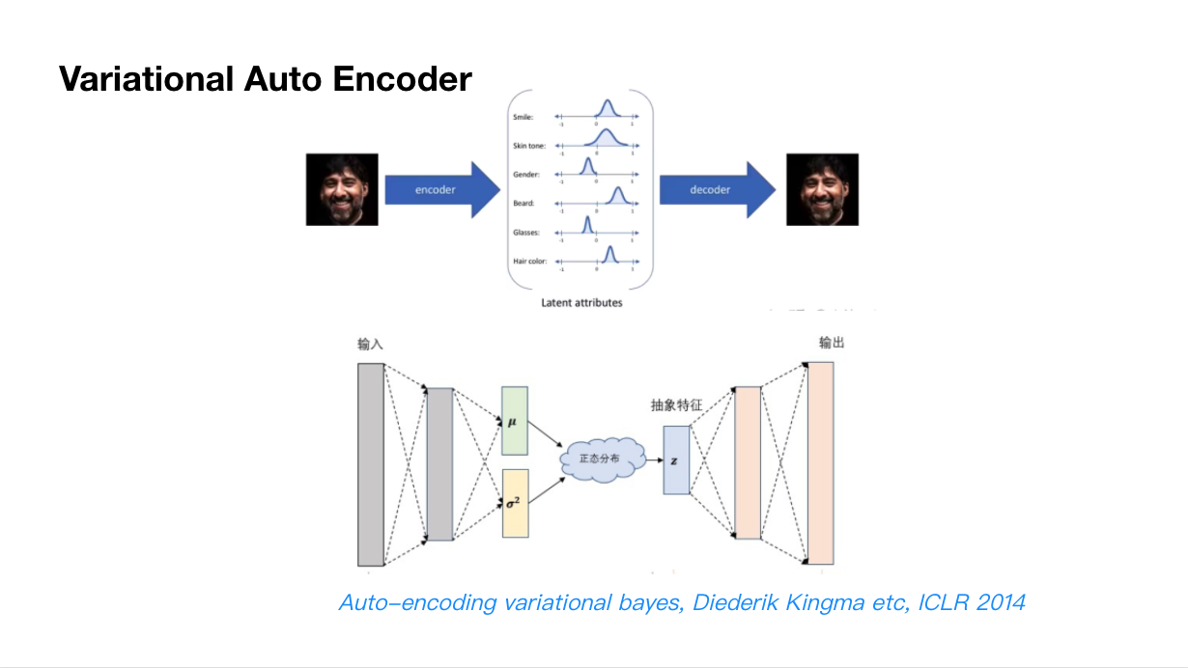

Slide 20
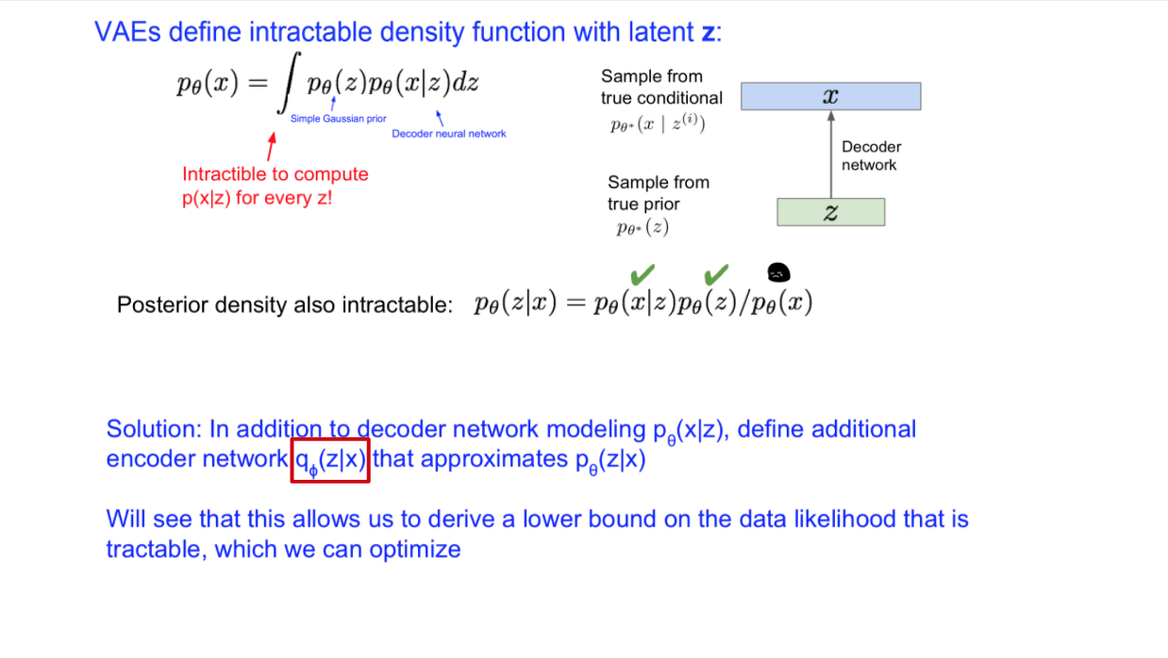

Slide 21
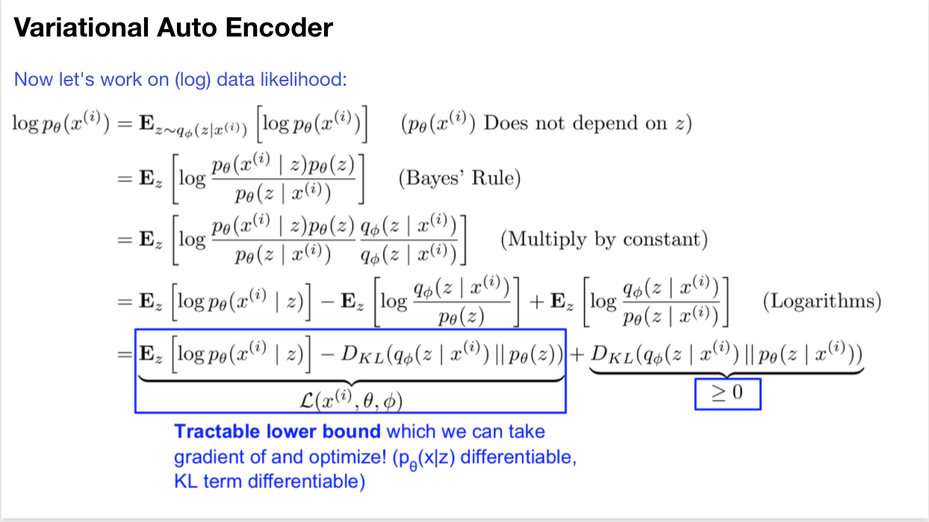

Slide 22
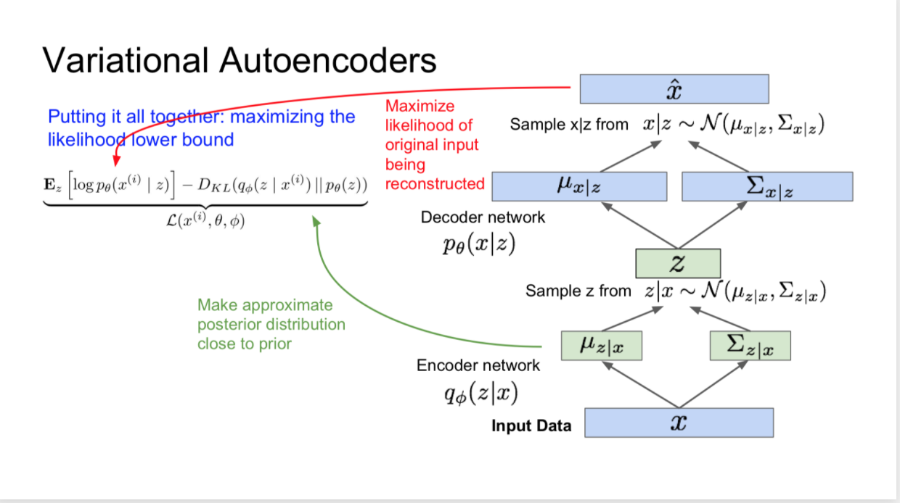

Slide 23
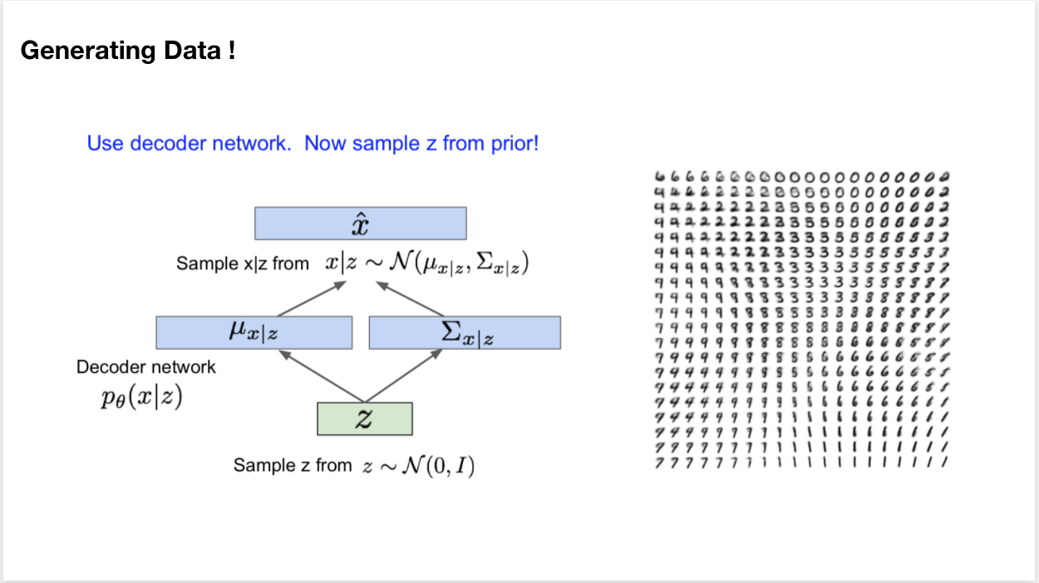

Slide 24
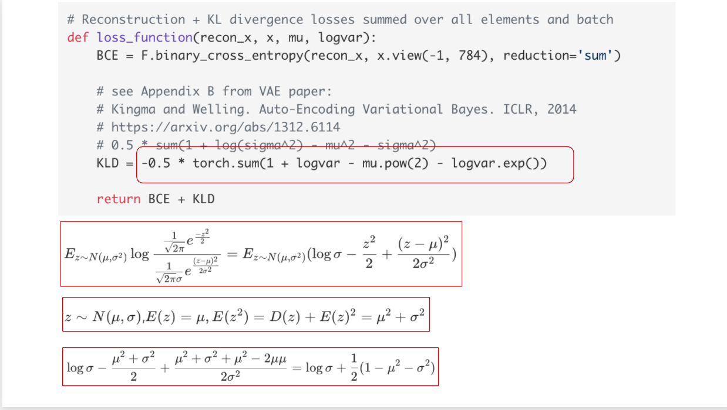

Slide 25
GAN: Generative Adverserial Nets

Slide 26
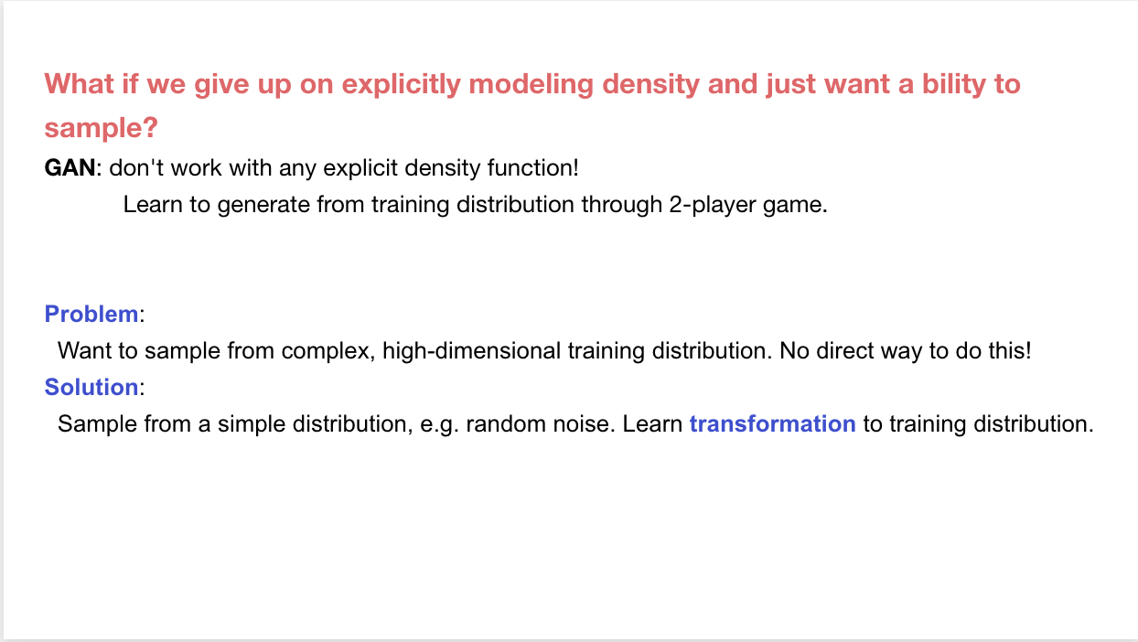

Slide 27
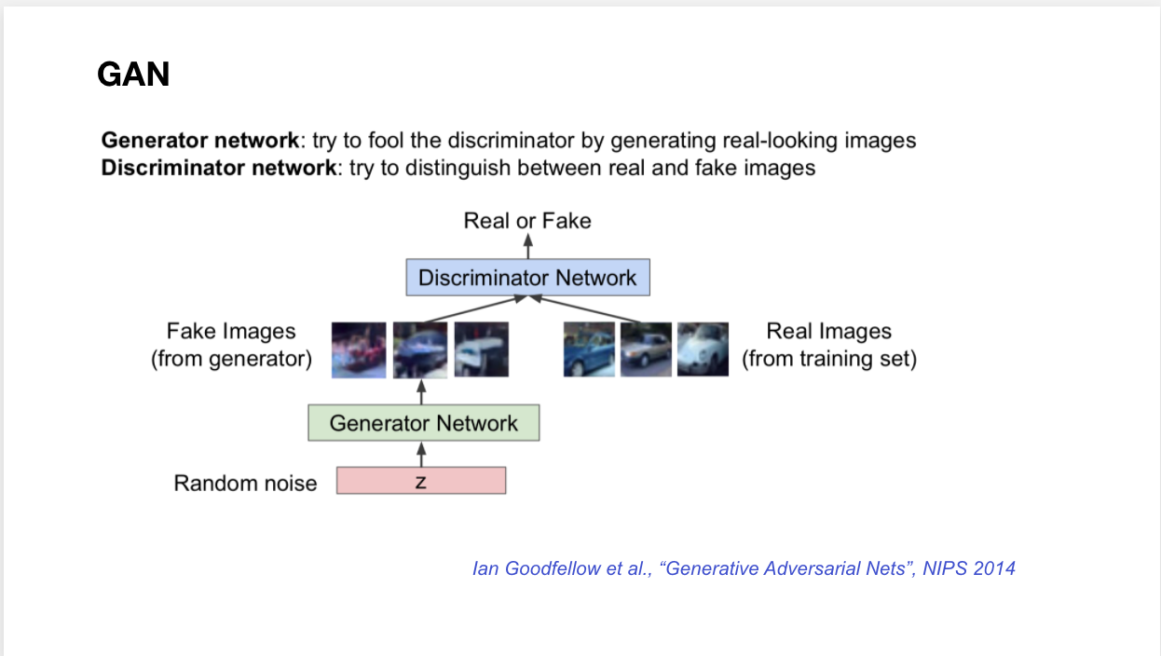

Slide 28
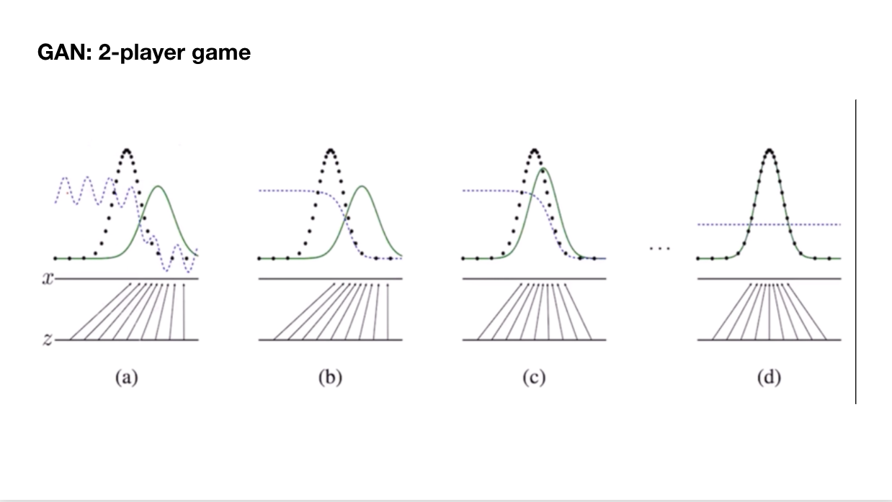

Slide 29
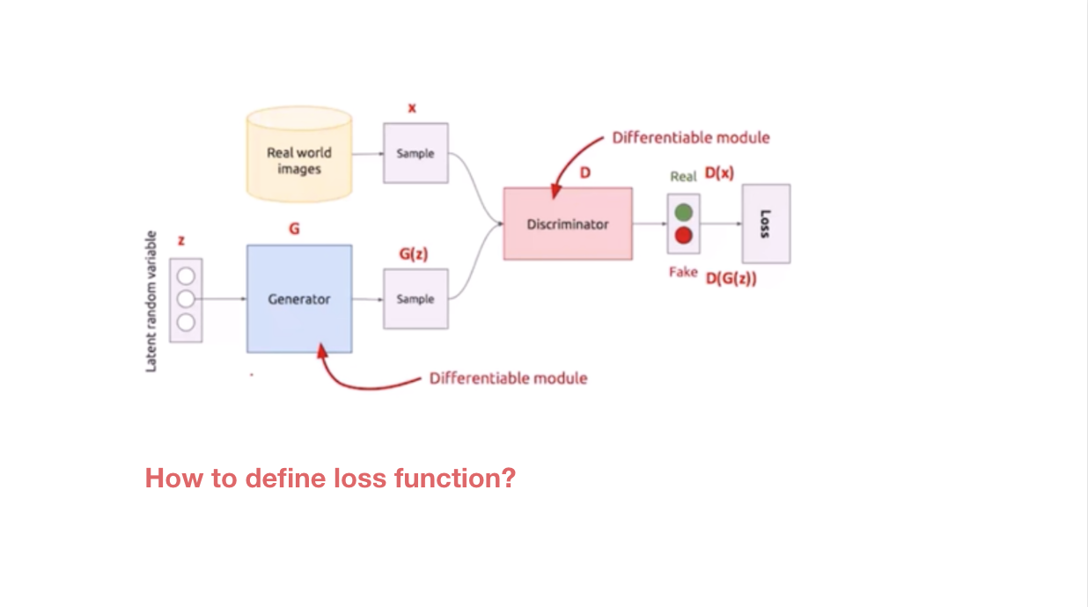

Slide 30
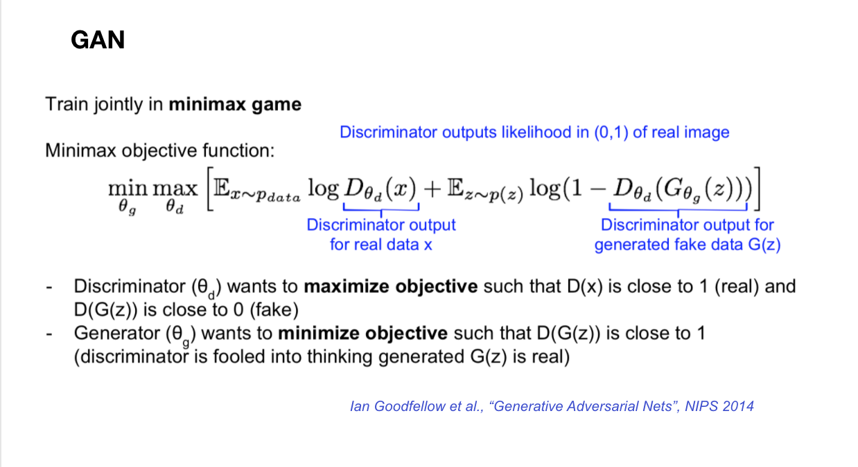

Slide 31
Projects
Take home Exercises
https://github.com/stasi009/TakeHomeDataChallenges
Kaggle Competition
https://www.kaggle.com/competitions
https://www.kaggle.com/c/optiver-realized-volatility-prediction/data
https://www.kaggle.com/c/wikipedia-image-caption/overview
Research Paper Review

